Slide 1
Introduction to HCI and User-Centered Design

Slide 2
Lecture 2
Understanding Users and Usability Principles

Slide 3
Introduction to User-Centered Design
User-Centered Design (UCD) is a design approach that focuses on users’ needs, goals, and limitations at every stage of system development.
Instead of designing for technology, we design for people.
Why UCD is Important?
Reduces user frustration
It improves usability
Increases product success
Saves development cost in long term
Who is my user?

Slide 4
User-Centered Design Principles
In order to evaluate a particular system with respect to HCI we use these 5 points known as UCD Principles
Mapped UCD Principle | Usability Goal | Explanation
1. Simplicity | Easy to learn | Simple design helps users understand the system quickly.
2. Consistency | Efficient to use | Consistent layout and commands improve task speed.
3. Visibility | Easy to remember | Visible options reduce the need to memorize commands.
4. Feedback | Error-free (or error-tolerant) | Feedback helps users detect and correct errors.
5. Accessibility | Satisfying | Accessible systems improve overall user satisfaction.

Slide 5
User-Centered Design Principles
1. Easy to learn → Simplicity A simple interface helps new users understand the system quickly and reduces cognitive load.
2. Efficient to use → Consistency Consistent layouts and commands allow users to perform tasks faster without relearning actions.
3. Easy to remember → Visibility Visible options and controls reduce the need for users to memorize commands.
4. Error-free (or error-tolerant) → Feedback Feedback informs users about actions and errors, helping them correct mistakes.
5. Satisfying → Accessibility Accessible systems support diverse users and improve overall user satisfaction.

Slide 6
Improving the System Based on User Needs
Step | Focus | Goal
1 | Understand Users | Identify needs and goals
2 | Involve Users | Collect feedback early
3 | Design Solutions | Create wireframes & prototypes
4 | Test with Users | Identify usability problems
5 | Iterate | Improve continuously

Slide 7
Cognitive Models
Explain how users think and process information
Based on perception, memory, attention, decision-making
Example:
Short-term memory is limited
Too many options → confusion

Slide 8
Mental Workload
Mental workload = amount of thinking effort required
High workload causes:
Errors
Slow performance
Frustration
Design goal:
Reduce user thinking effort

Slide 9
UX vs Usability
UX (User Experience) includes the complete overall experience of the user.
Usability focuses only on how easy a system is to use
UX (User Experience) | Usability
Overall experience | Ease of use
Emotions & satisfaction | Efficiency & effectiveness
Broader concept | Part of UX

Slide 10
Jakob Nielsen’s 10 Usability Heuristics
Visibility of system status – Show users what’s happening (e.g., loading bars).
Match system & real world – Use familiar words, visuals and concepts.
User control & freedom – Let users undo/redo actions easily.
Consistency & standards – Keep design uniform and predictable (sight icons).
Error prevention – Avoid mistakes before they happen.
Recognition over recall – Make options visible; reduce memory load.
Flexibility & efficiency – Support both beginners and experts (use shortcuts).
Minimalist design – Keep interface simple and uncluttered.
Help users recover from errors – Give clear, helpful error messages.
Help & documentation – Provide guidance when needed.
Notes:
Jakob Nielsen is a Danish computer scientist and usability expert.
He is famous for his work on user interface design and usability, and he created the 10 usability heuristics as general rules to help designers make systems easier to use.

Slide 11
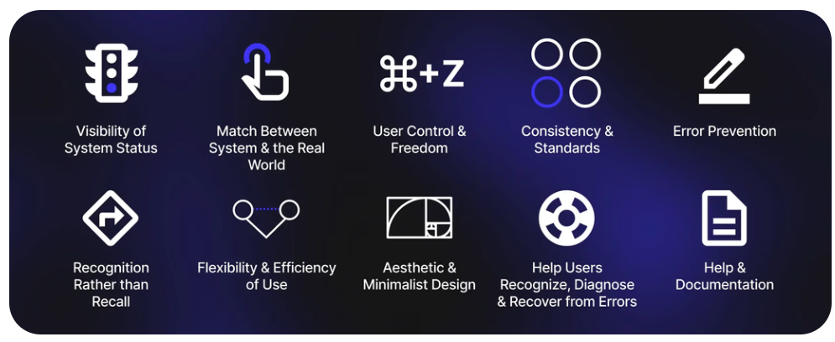

Slide 12
A drawing/painting application (like MS Paint)
Heuristic | Example in Drawing App
1. Visibility of system status | Show a “Saving…” or “Undo successful” message
2. Match system & real world | Tool names like “Brush,” “Eraser,” “Fill”
3. User control & freedom | Undo/redo strokes anytime
4. Consistency & standards | Same icon shapes/colors for tools across menus
5. Error prevention | Warn before closing unsaved drawings
6. Recognition over recall | Show icons for tools instead of making user remember commands
7. Flexibility & efficiency | Keyboard shortcuts for experienced users (Ctrl+Z, Ctrl+Y)
8. Minimalist design | Only main tools visible; advanced options in side menu
9. Help users recover from errors | Prompt to recover last session after a crash
10. Help & documentation | Built-in tips or quick-start tutorial available

Slide 13
Let’s consider a scenario in computer graphics, like a 3D modeling software (e.g., something like Blender or Autodesk Maya). Here’s how Jakob Nielsen’s 10 usability heuristics can be applied:
Heuristic | Example in 3D Graphics Software
1.Visibility of system status | Show progress bar when rendering a scene
2.Match system & real world | Tools named “Move,” “Rotate,” “Scale”
3. User control & freedom | Undo/redo transformations easily
4. Consistency & standards | Toolbar icons and shortcuts consistent across views
5. Error prevention | Confirm before deleting main camera or light
6. Recognition over recall | Show icons for common actions like extrude or bevel
7. Flexibility & efficiency | Shortcuts for experts, drag tools for beginners
8. Minimalist design | Only essential panels shown; extras in menus
9. Help users recover from errors | Suggest how to relink missing textures
10. Help & documentation | Tooltips and tutorials accessible from interface

Slide 14
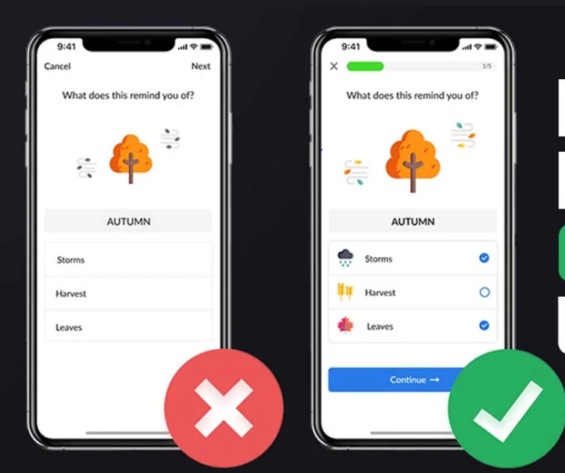
Good UX Example
Features of good design:
Clear navigation
Simple layout
Fast response
Clear feedback
Result: ✔ Users feel comfortable ✔ Fewer mistakes

Slide 15
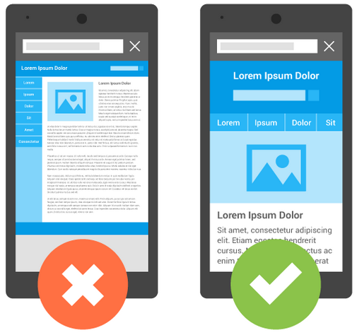
Bad UX Example
Problems:
Too many buttons
Confusing menu
No feedback
Small text
Result: ❌ User frustration ❌ High error rate

Slide 16


Slide 17
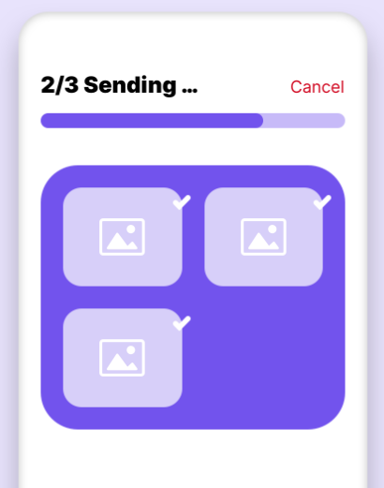
1. Visibility of system status

Slide 18
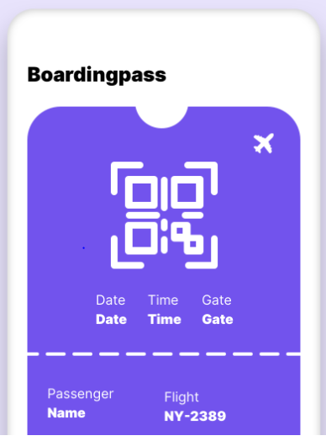
2. Match between system and the real world

Slide 19
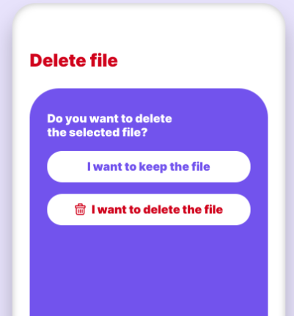
3. User control and freedom

Slide 20
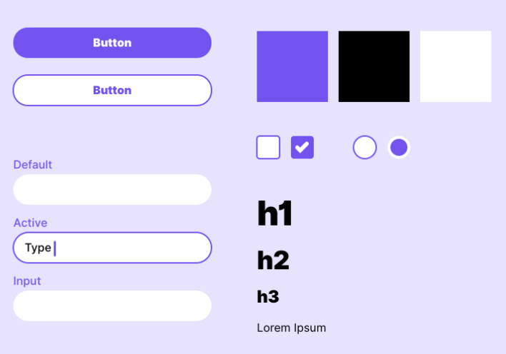
4. Consistency and standards

Slide 21
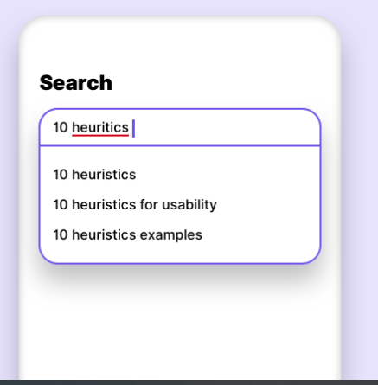
5. Error prevention

Slide 22
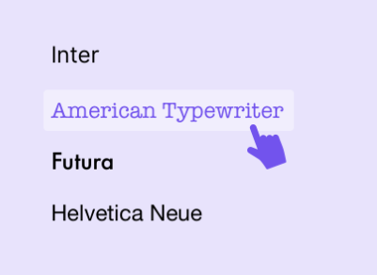
6. Recognition rather than recal

Slide 23
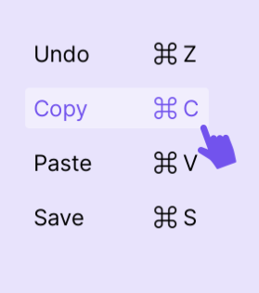
7. Flexibility and efficiency of use

Slide 24
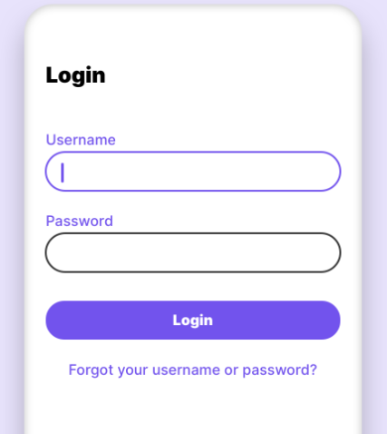
8. Aesthetic and minimalist design

Slide 25
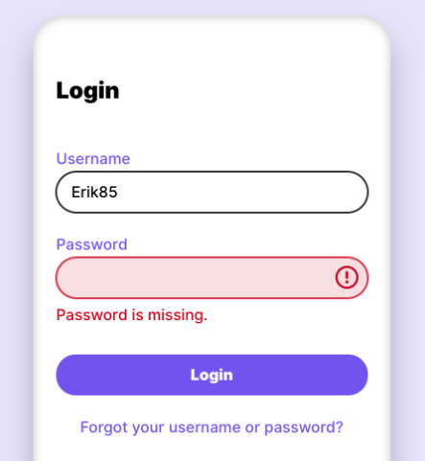
9. Help users recognize, diagnose, and recover from errors

Slide 26
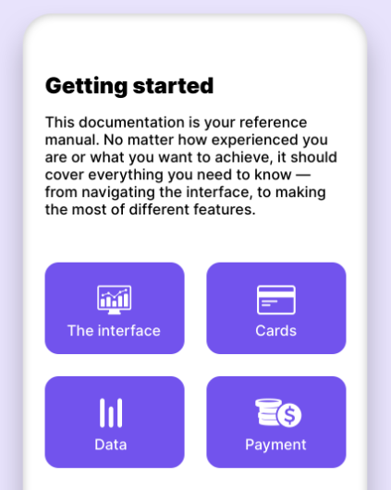
10. Help and documentation

Slide 27


Slide 28
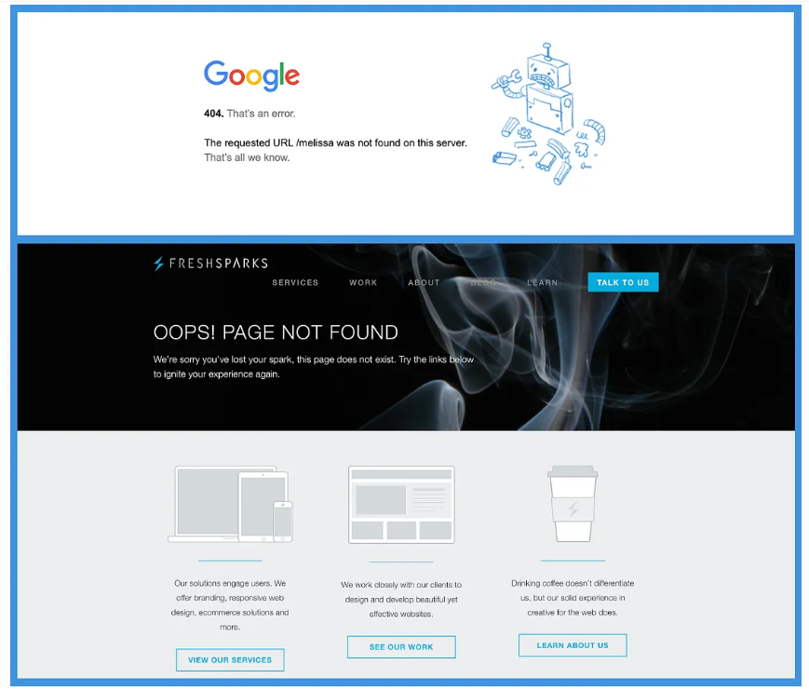

Slide 29
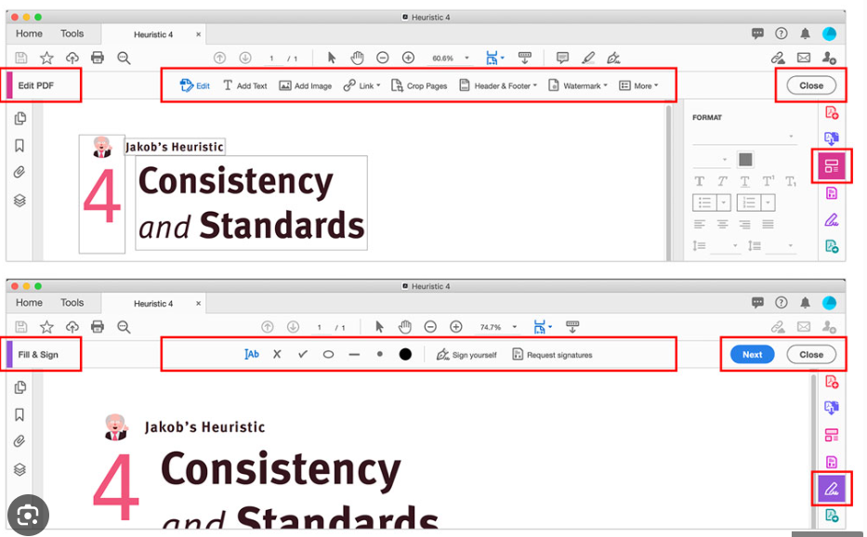

Slide 30
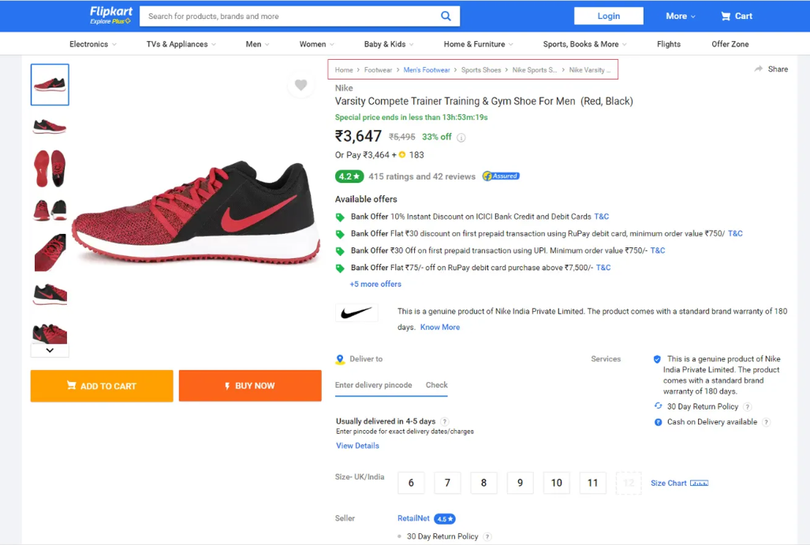

Slide 31
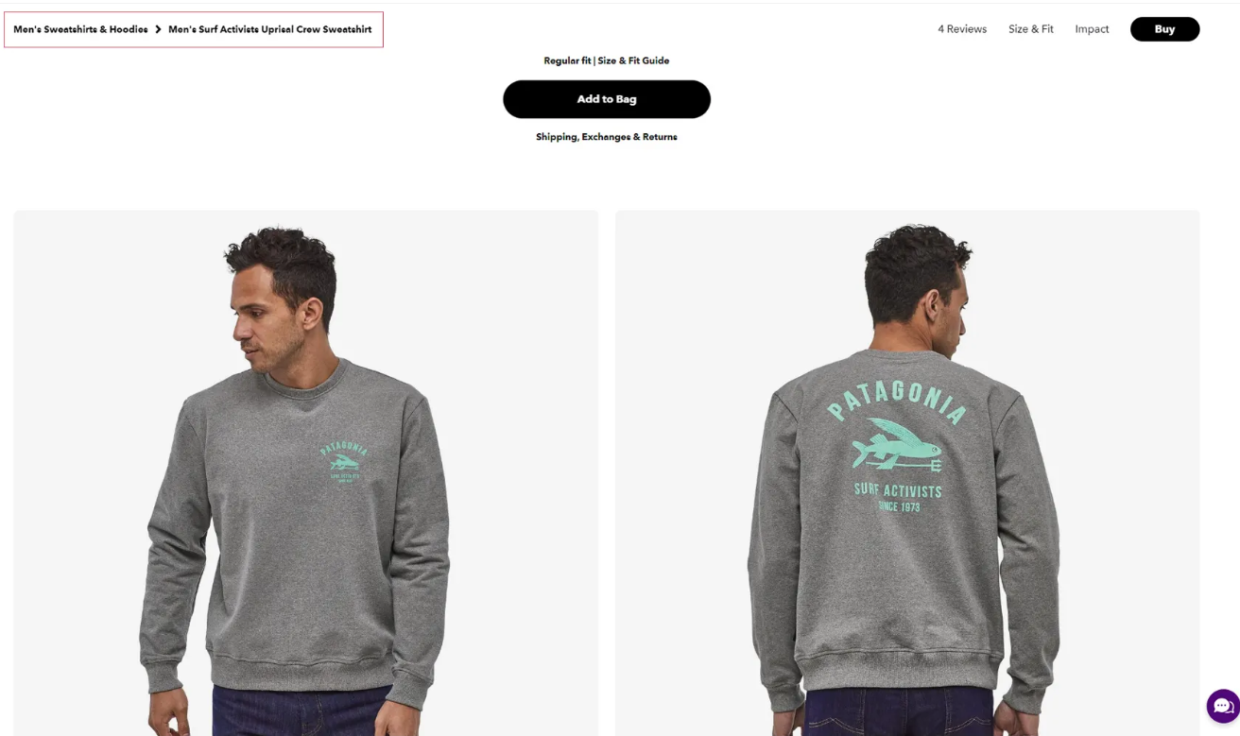

Slide 32
